Slide 1
Lecture 9
STAT 451 VISUALIZING DATA
Fall 2023
Many thanks to Prof. Abel Rodriguez, many slides from this course are adapted from his data visualization class.

Slide 2
Composition
Composition (sometimes called design, form, visual ordering, or formal structure) is the placement or arrangement of visual elements or ingredients in a work of art.
Some elements of a composition:
Line and shape.
Color.
Texture.
Tone.
Space (positive and negative).

Slide 3
Principles of composition
There should be a center of interest or focus in the work, to prevent it becoming a pattern in itself.
Elements at the top, the left or the center of the visualization tend to be visually more “important”.
The visual center of any page is just slightly above and to the right of the actual (mathematical) center. This tends to be the natural placement of visual focus.
Contrast (color, size, direction, change in alignment) can be used to highlight important elements.
The prominent subject should be off-center, unless a symmetrical or formal composition is desired, and can be balanced by smaller satellite elements.

Slide 4
Principles of composition
The direction followed by the viewer's eye should lead the viewer's gaze around all elements in the work before leading out of the picture.
Use “lines” to guide the viewer’s eye.
Exact bisections of the space should be avoided:
Rule of thirds: imagine the design as divided into nine equal parts by two equally-spaced horizontal lines and two equally-spaced vertical lines, and that important compositional elements (main/larger visualizations) should be placed along these lines or their intersections.

Slide 5

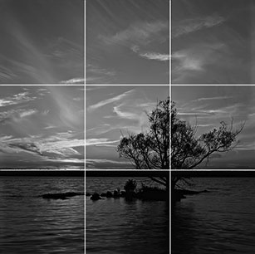
The rule of thirds …

Slide 6
Principles of composition
Consistency and repetition are important!
If appropriate, use small multiples of a common design when creating multiple visualizations.
Consistent use of color, font and decorative elements across the infographic.
Make sure that distinct elements are connected.
Hierarchy.
Alignment.
Proximity.

Slide 7
Principles of composition
Boring … until it’s not!
Balance, organization, harmony, continuity … these must dominate!
However, they must be subtly broken to highlight a specific elements of the design!

Slide 8
Lines and Composition
Lines can be created by borders of areas of differing color or contrast, or sequences of discrete elements.
Lines influence the direction of the viewer's gaze.
Straight lines add affection and can make the design look more detailed and challenging (hard edges).
Curved lines are generally used to create a sense of flow within an image (soft, aesthetically pleasing).
Having many lines without a clear subject point suggest chaos in the image and may conflict with the mood you are trying to evoke.

Slide 9
Hierarchy
Visual hierarchy refers to the order in which the human eye perceives what it sees.
Objects with the highest contrast to their surroundings are recognized first.
The concept is based in Gestalt psychological theory, which proposes that the human brain has innate organizing tendencies.
Elements that do not match these organization stand out, but having too many leads to a feeling of disorganization and discomfort.

Slide 10
Hierarchy
Similarly to lines, hierarchy can be used to guide the eye to information in a specific order or for a specific purpose.
Visual hierarchy can be compared to grammatical structure in writing.
There are a number of tools that can be used to establish hierarchy:
Alignment
Color
Character (e.g., fonts, shape)
Size
Avoid using too many levels in your hierarchy!

Slide 11

Hierarchy

Slide 12
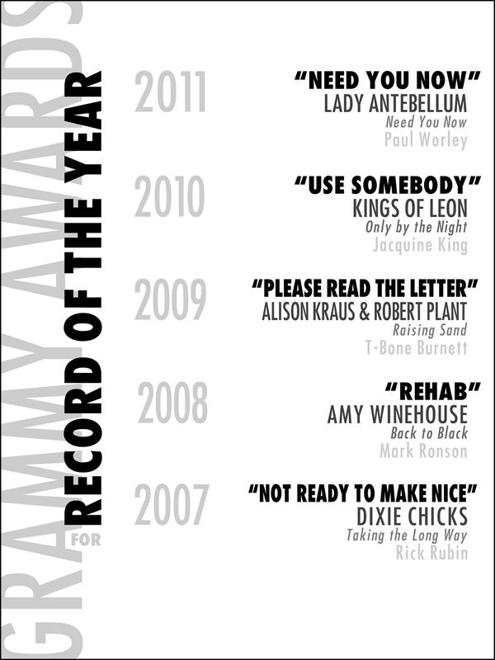
Hierarchy

Slide 13
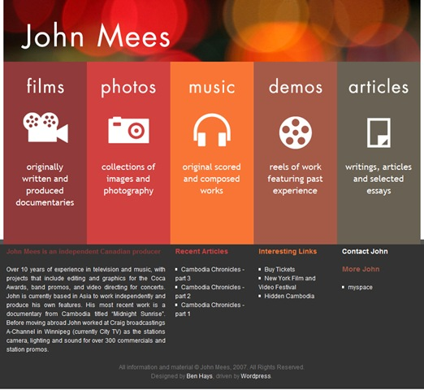
Hierarchy

Slide 14
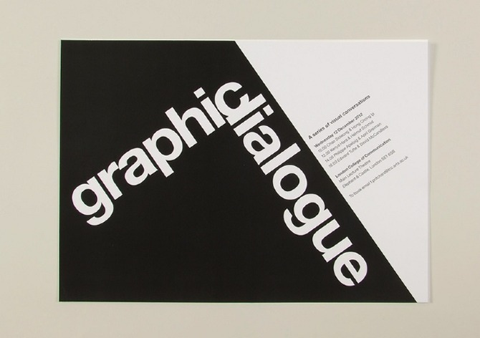
Hierarchy

Slide 15
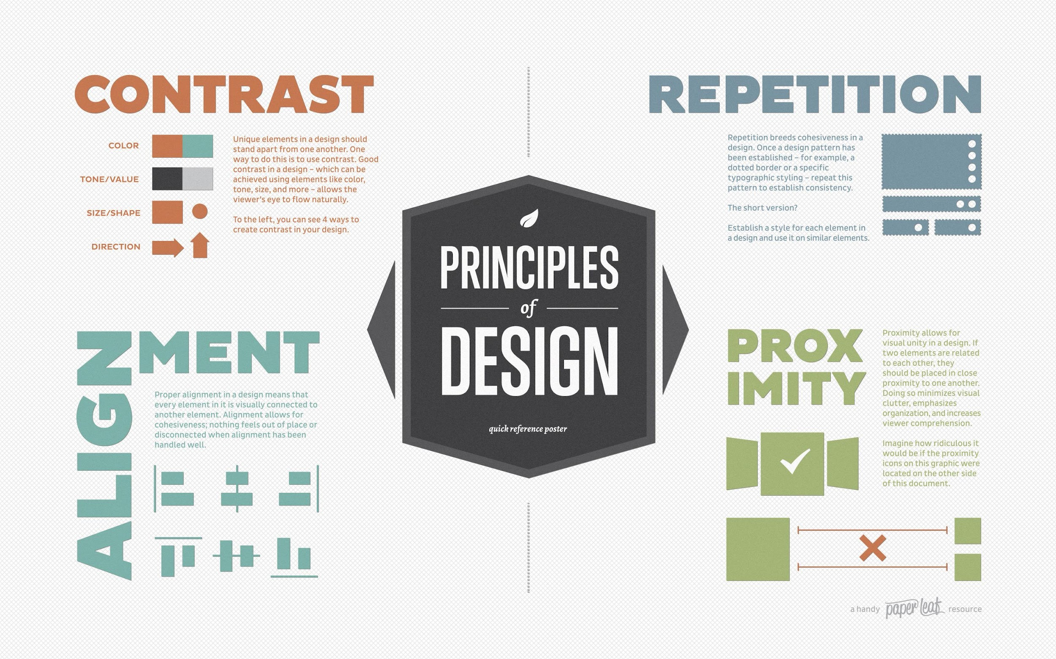
Hierarchy

Slide 16
Alignment
Alignment is the placement of text and graphics so they line up on the page (horizontal, center, vertical, edge, etc).
Lack of alignment creates a sloppy, unorganized look.
Mixing too many alignments can have a similar effect.
Alignment allows you to:
Create order.
Organize page elements
Group items.
Create visual connections.

Slide 17
Alignment
In infographics, where you typically use multiple levels in the hierarchy, you might need to use different types of alignments within each level.
For text, left alignment usually works best.
Break alignment when it serves a specific purpose such as to intentionally create tension or draw attention to a specific element on the page!

Slide 18
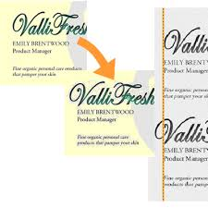
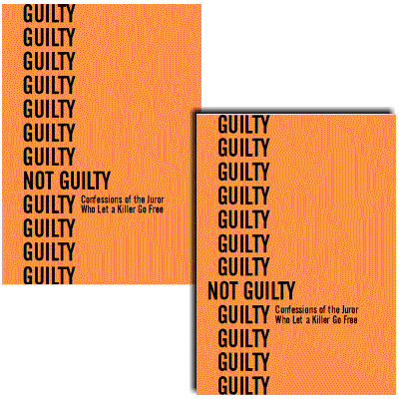
Alignment
Visual alignment
Breaking alignment

Slide 19
Alignment and Grids
A grid is a structure (usually two-dimensional) made up of a series of intersecting straight (vertical, horizontal, and angular) or curved guide lines used to structure content.
A grid serves as an armature on which a designer can organize graphic elements (images, glyphs, paragraphs) in a rational, easy to absorb manner.
Organize graphic elements in relation to a page
In relation to other graphic elements on the page,
Or relation to other parts of the same graphic element or shape.

Slide 20
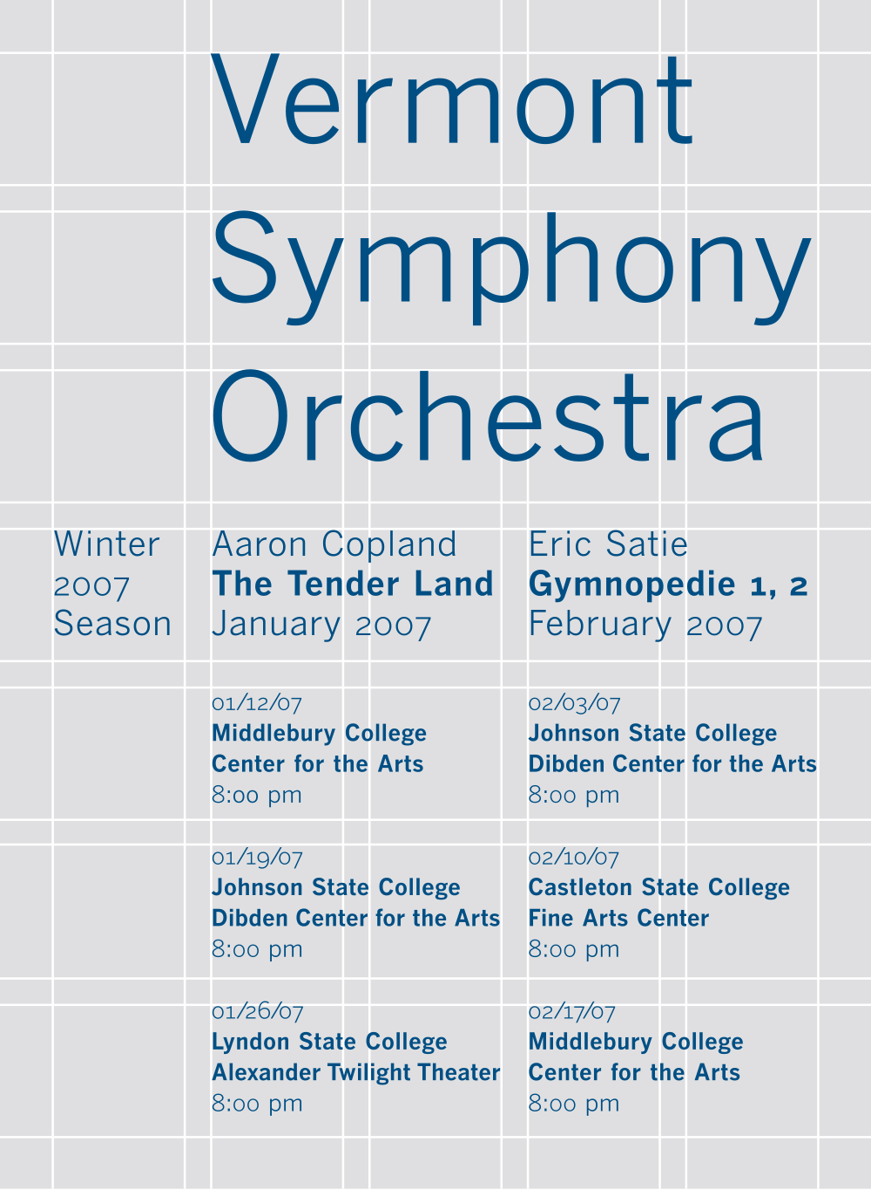
Alignment and Grids
Grids are an extremely useful in composition, helping to ensure appropriate alignment and spacing of elements.
A grid is divided in square or rectangular “units”, which might be separated by “alleys”.

Slide 21
Grid-based composition
Choose a grid based on the content and adjust content based on the grid.
Because infographics typically involve many elements of different sizes, grids with a large number of horizontal and vertical units are more useful (flexibility is key!).
Then, resize object to fit on the grid.
Grids can feel stifling:
Layouts based on grids are not appropriate in all cases.
Grids should fit the mix of elements rather than forcing elements to fit the grid.

Slide 22
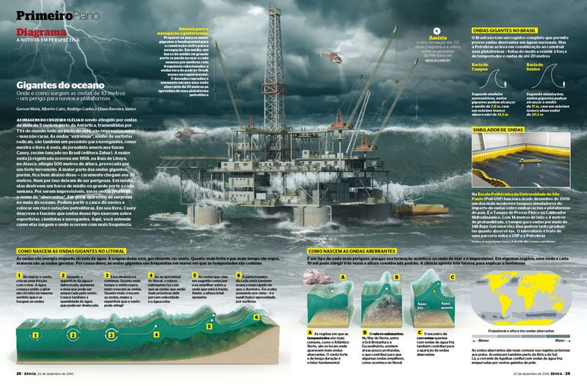
Nested grids
http://infographicsnews.blogspot.com/2011/04/alberto-cairo-brazilian-infographics.html

Slide 23
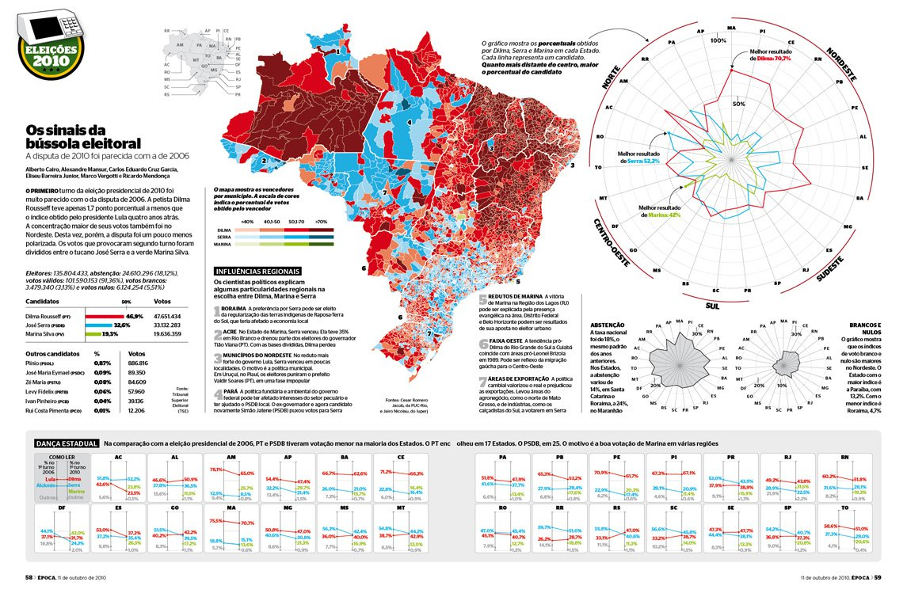
Less rigid grids
“Broken” grid, arrow needs to added!!!
“Broken” grid
Shading and vertical lines help enforce the visual hierarchy and suggest the grid

Slide 24
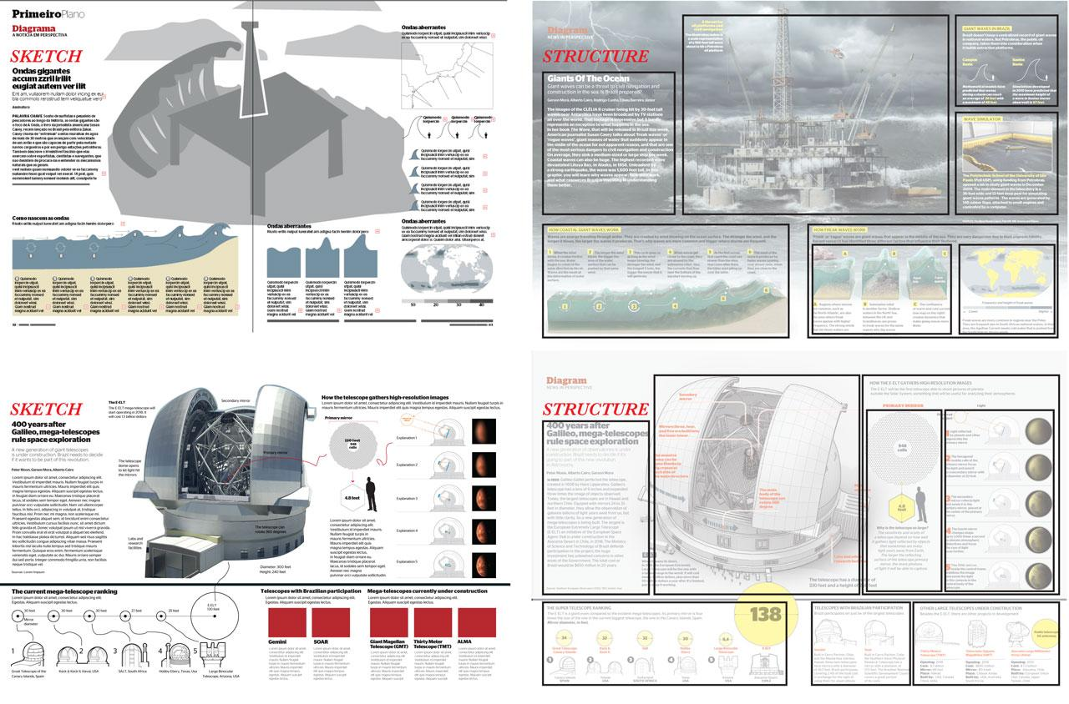
More examples of grids

Slide 25
Grid-based composition
I strongly recommend that you use a grid in your own designs, at least in the beginning.
As you become more practiced, you can consider slight deviations from the grid (see our previous examples), but try to keep those to a minimum.

Slide 26
Proximity and “negative” space
Placing elements in close proximity to one another is another way to establish visual hierarchies.
Varying degrees of proximity suggest different degrees of relationship.
However, too much proximity can reduce readability
Clutter is the enemy of clarity!!!

Slide 27
Proximity and “negative” space
Distance is not the only consideration when discussing proximity!
Elements of the infographic (graphs, text, etc.) that discuss connected issues should appear next to each other.
The position of the different elements should reflect the expected flow of reading.
The story you are trying to tell determines the relative position of the elements.

Slide 28
Proximity and “negative” space
Negative space is the space that surrounds an object in a image. Just as important as that object itself, negative space helps to define the boundaries of positive space and brings balance to a composition.
If in doubt, err on the side of a bit more negative space.
Negative space can be used for decorative purposes.

Slide 29
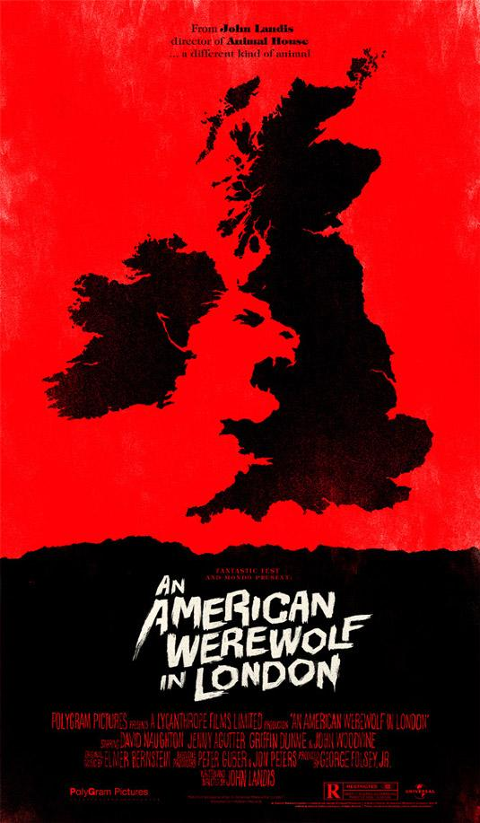

Negative space and decoration

Slide 30

Negative space and decoration

Slide 31
Balance
Balance is an equilibrium that results from looking at images and judging them against our ideas of physical structure (such as mass, gravity or the sides of a page).
It is the arrangement of the objects in a given design as it relates to their visual weight within a composition.
Balance usually comes in two forms: symmetrical and asymmetrical.

Slide 32
Symmetrical balance
Symmetrical (formal) balance occurs when the weight of a composition is evenly distributed around a central vertical or horizontal axis.
Under normal circumstances it assumes identical forms on both sides of the axis.
When symmetry occurs with similar, but not identical, forms it is called approximate symmetry.
If a composition equally around a central point resulting in radial symmetry.

Slide 33
Asymmetrical Balance
Asymmetrical (informal) balance occurs when the weight of a composition is not evenly distributed around a central axis.
It involves the arranging of objects of differing size in a composition such that they balance one another with their respective visual weights.
Often there is one dominant form that is offset by many smaller forms.
Asymmetrical compositions tend to have a greater sense of visual tension (more interesting).

Slide 34
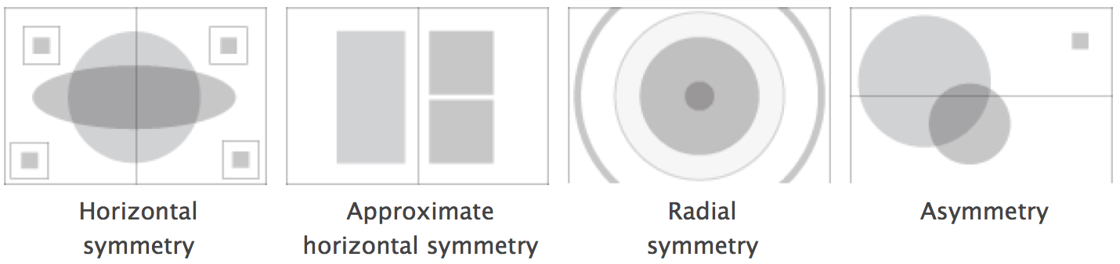
Balance

Slide 35
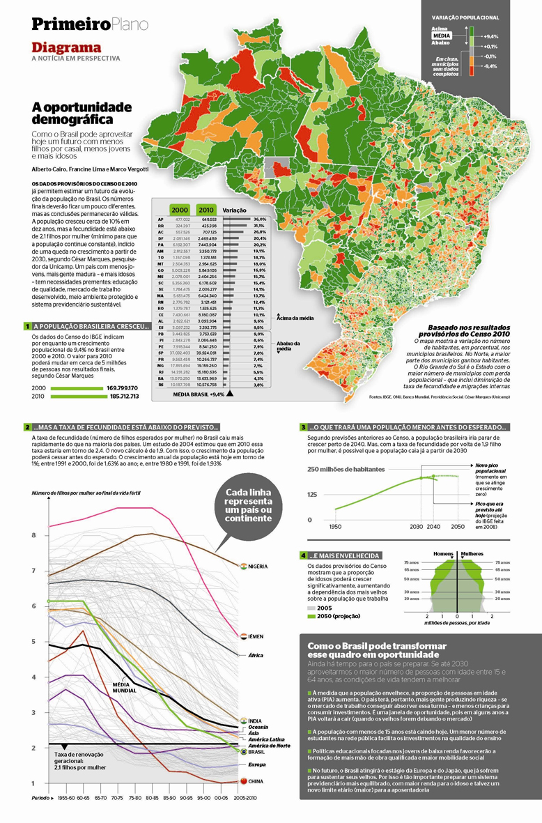
Principles of composition
The demographic dividend visualization places the map in the visual center, and balances it out with the line plot in the bottom left corner!
It also uses a grid system to locate the different components of the visualization.

Slide 36
Rhythm
Rhythm is the repetition or alternation of elements, often with defined intervals between them.
Rhythm can create a sense of movement, and can establish pattern and texture.
There are many different kinds of rhythm, often defined by the feeling it evokes when looking at it.
Regular.
Flowing.
Progressive.
Grids are also helpful in creating rhythm.

Slide 37
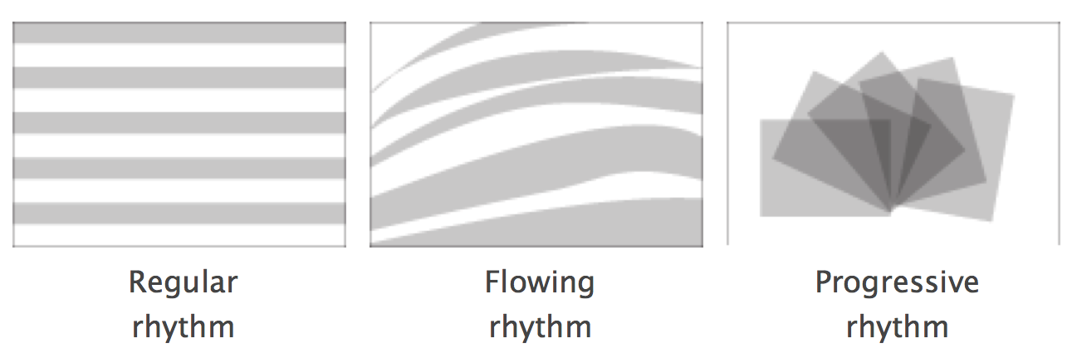
Rhythm

Slide 38
Proportion
Proportion is the comparison of dimensions or distribution of forms. It is the relationship in scale between one element and another, or between a whole object and one of its parts.
The golden ratio (1 : 1.618) is often considered to be aesthetically pleasing (this goes back to Greek sculpture, where it was used consistently).

Slide 39
Sketches
Finding the right grid or composition is often difficult and it will take more than one try!
Using (possibly hand drawn) sketches is a good way to try out ideas before embarking into a full draft.

Slide 40
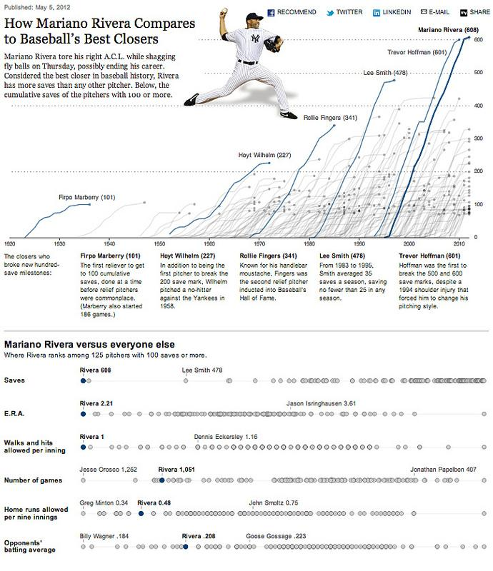
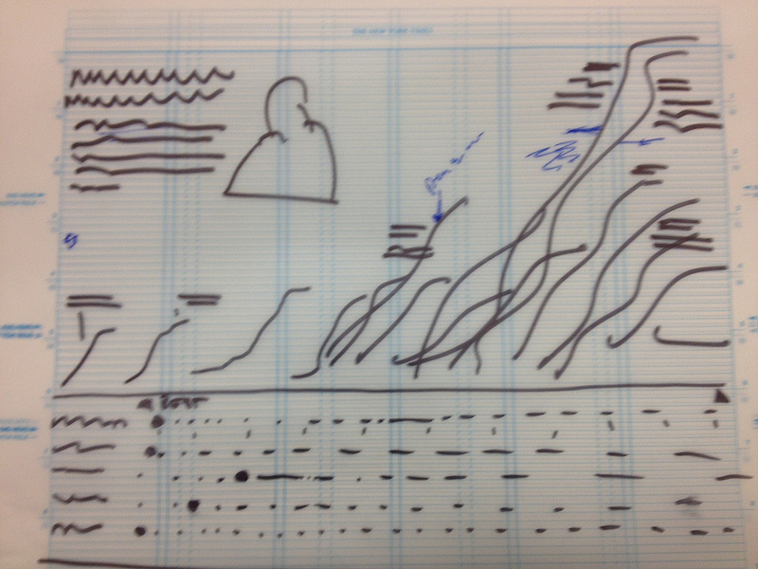
Sketches …
This graph in the NY Times …
Started as this sketch …
http://www.nytimes.com/interactive/2012/05/05/sports/baseball/mariano-rivera-and-his-peers.html?ref=baseball

Slide 41
Sketches …
Interestingly, this graph (as most the NY Times visualizations) were created using R and Adobe Illustrator … Just like you are asked to do for our final project!!!

Slide 42
Color
We discussed color perception when we discussed visual cues.
The principles for using color in an infographic are similar, but there are some important differences.

Slide 43
Color
Keep the number of hues you plan to use under control!
Pick a palette with two or at the most three primary colors. If you need additional colors, generated them by modifying the lightness and/or saturation.
Pick colors that work well together! See what others are doing and/or use color-creation tools.
Pick colors that fit and reflect the theme of the infographic.
http://www.empower-yourself-with-color-psychology.com/cultural-color.html
http://www.amazon.com/Color-Messages-Meanings-PANTONE-Resource/dp/0971401063/ref=pd_sim_b_1?ie=UTF8&refRID=1S6X1HX24HAZ86XSKFB6

Slide 44
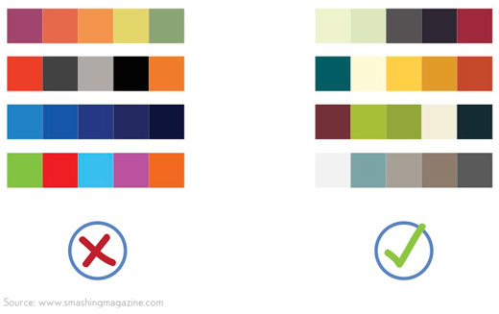
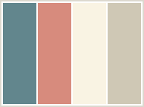
Color
http://www.colorcombos.com
http://www.colourlovers.com/palettes

Slide 45
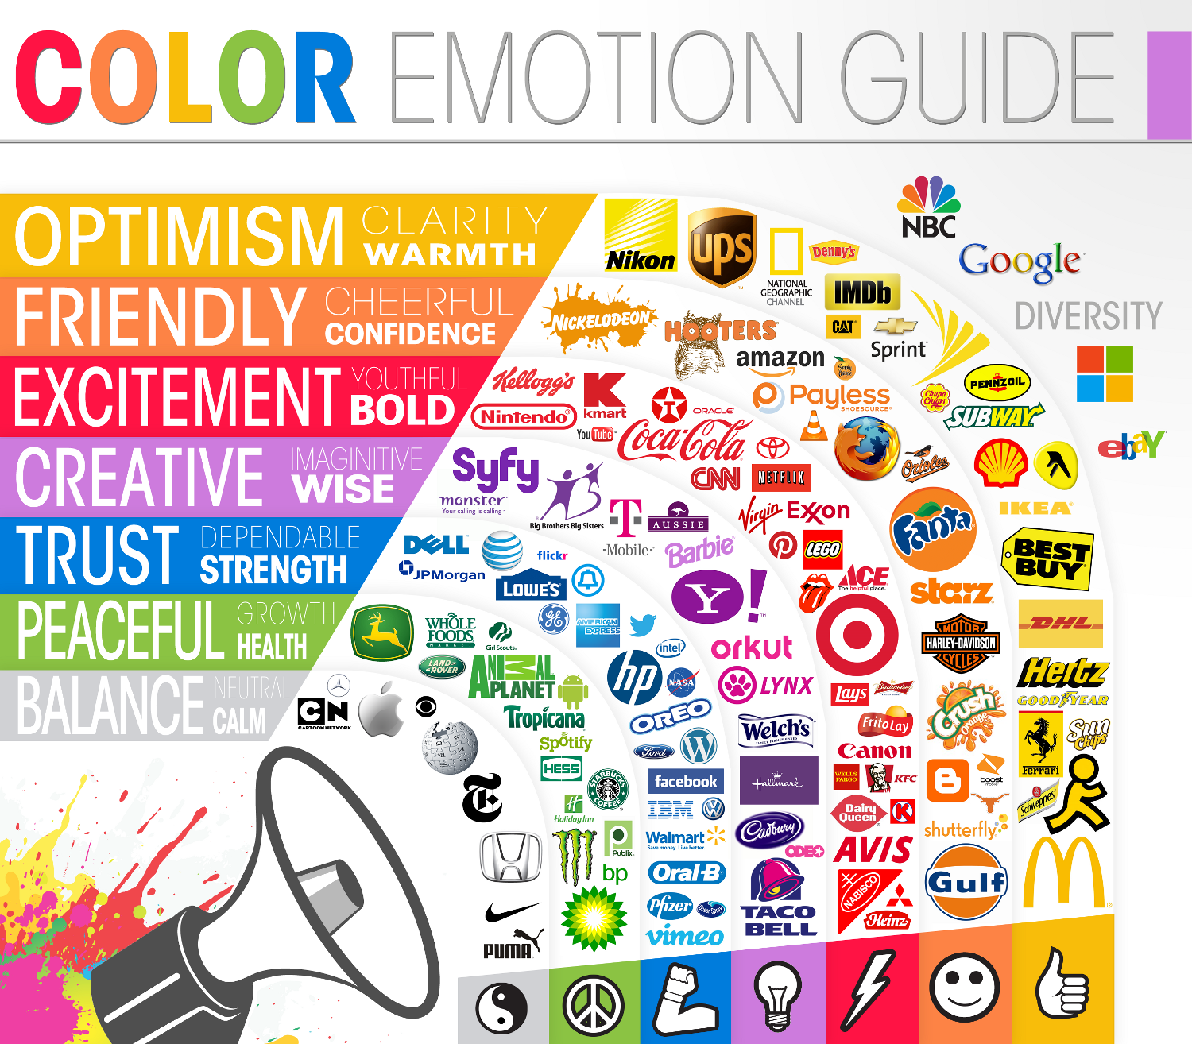
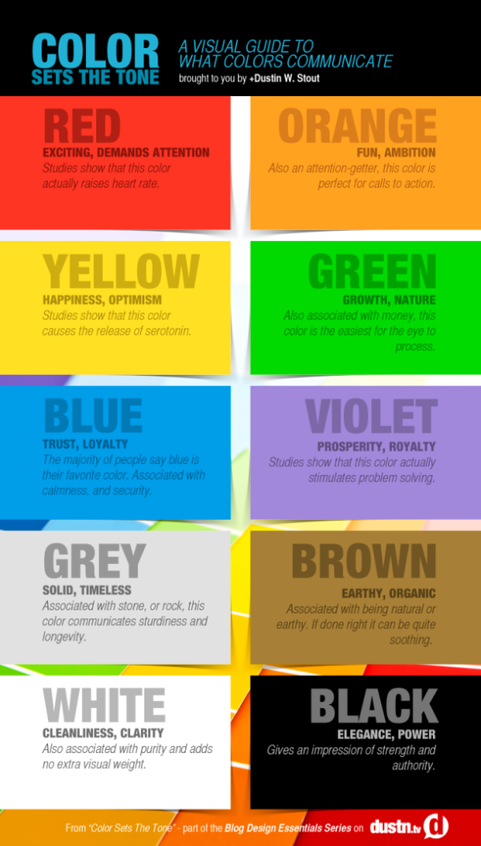
Color

Slide 46
Color
Be consistent in the use of color for background and titles!
Avoid sharp colors for your background!
For printed infographics white is typically the background of choice (but don’t be limited by it!)
Some designers argue that for infographics that will be viewed mostly on the web you should avoid white on the background.
Harmonize the colors in your visualizations with the color palette for the whole infographic.

Slide 47
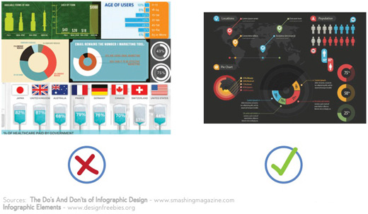
Color
Too many colors in the palette, inconsistent background!

Slide 48
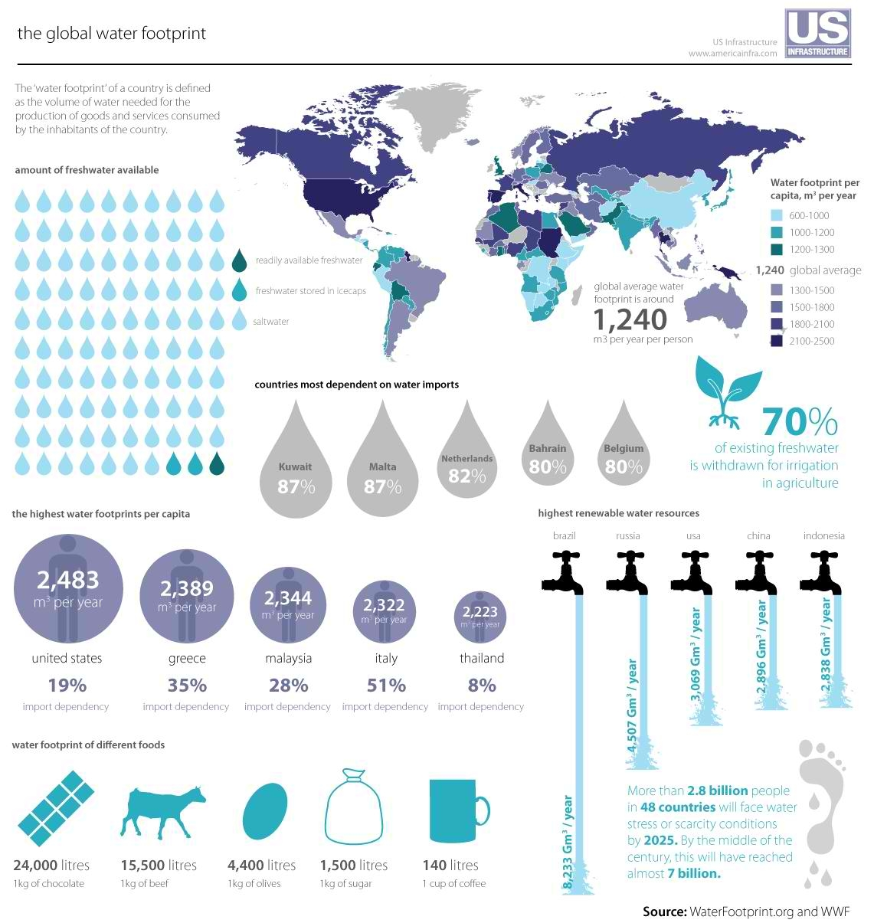
Color
Color palette based on blues because of the theme of the infographic (water).
All individual components share on the same color palette.

Slide 49
Color
Just like font, color can be used to create visual hierarchies and to attract the attention of the reader towards specific areas.
Combine the two!
Similarly “negative space” (“white space”) can be effectively used to visually separate components and establish a hierarchy.
Don’t be shy when using blank space.

Slide 50
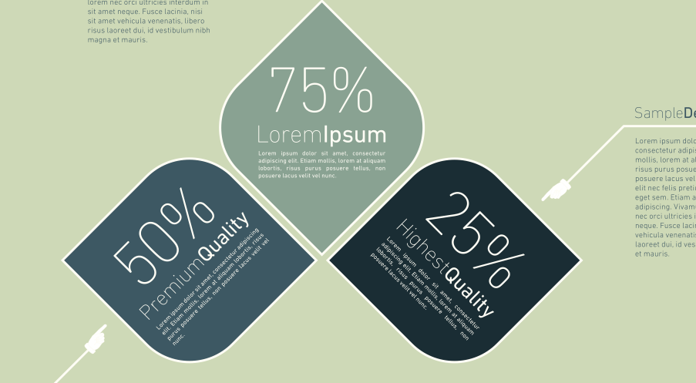
Color

